Slide 1
BRANCH AND BOUND TRAVELLING SALESMAN PROBLEM SUBHASHIS TRIPATHY[RA2112703010020] AKASH MS[RA2112703010023]

Slide 2
INTRODUCTION

Slide 3
The Travelling Salesman Problem (TSP) is a well-known issue in the fields of operations research and optimization. The task at hand is to determine the quickest path a salesperson can take to visit a group of cities, where each location must be visited precisely once before the salesman returns to the first location. The TSP has been researched for more than a century and is still an active topic of study today. It has applications in a variety of industries, including manufacturing, logistics, transportation planning, and network optimization.

Slide 4
PROBLEM STATEMENT

Slide 5
The Travelling Salesman Problem (TSP) can be stated as follows: Given a set of cities and the distances between each pair of cities, find the shortest possible route that a salesman can take to visit each city exactly once and return to the starting city.
More formally, let G = (V, E) be a complete graph with n vertices, where V is the set of cities and E is the set of edges between them. Each edge (i, j) ∈ E is associated with a non-negative cost or distance cij, representing the cost or distance of travelling from city i to city j. The TSP can be formulated as the problem of finding a Hamiltonian cycle in G that has minimum cost.
A Hamiltonian cycle is a cycle in G that visits each vertex exactly once and returns to the starting vertex. The TSP imposes the additional constraint that the Hamiltonian cycle must have minimum cost.

Slide 6
ALGORITHM

Slide 7
We will use the dynamic programming approach to solve the Travelling Salesman Problem (TSP).
Before starting the algorithm, let’s get acquainted with some terminologies:
A graph G=(V, E), which is a set of vertices and edges.
V is the set of vertices.
E is the set of edges.
Vertices are connected through edges.
Dist(i,j) denotes the non-negative distance between two vertices, i and j.

Slide 8
IMPLEMENTATION

Slide 9
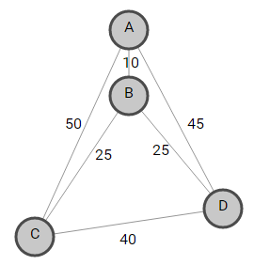
Given a set of cities and the distance between every pair of cities, the problem is to find the shortest possible route that visits every city exactly once and returns to the starting point.
For example, consider the following graph. A TSP tour in the graph is A —> B —> C —> D —> B —> A. The cost of the tour is 10 + 25 + 40 + 25 + 10 = 100.

Slide 10
The term Branch and Bound refer to all state-space search methods in which all the children of an E–node are generated before any other live node can become the E–node. E–node is the node, which is being expended. State–space tree can be expended in any method, i.e., BFS or DFS. Both start with the root node and generate other nodes. A node that has been generated and whose children are not yet been expanded is called a live-node. A node is called a dead node, which has been generated, but it cannot be expanded further. In this method, we expand the most promising node, which means the node which promises that expanding or choosing it will give us the optimal solution. So, we prepare the tree starting from the root and then expand it.
We have a cost matrix defined by:
C(i, j) = W(i, j), if there is a direct path from C_{i} to C_{j} = INFINITY, if there is no direct path from C_{i} to C_{j}
For example, consider the following cost matrix M,

Slide 11
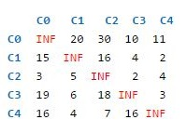
Here, C(0, 2) = 30 C(4, 0) = 16 C(1, 1) = INFINITY
Following is the state-space tree for the above TSP problem, which shows the optimal solution marked in green:

Slide 12
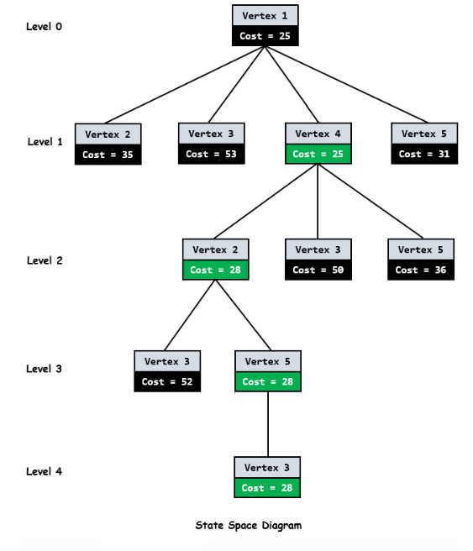

Slide 13
As we can see from the above diagram, every node has a cost associated with it. When we go from the city i to city j, the cost of a node j will be the sum of the parent node i, the cost of an edge (i, j), and the lower bound of the path starting at node j.
As the root node is the first node to be expanded, it doesn’t have any parent. So, the cost will be only the lower bound of the path starting at the root.
Now, how do we calculate the lower bound of the path starting at any node?
In general, to get the lower bound of the path starting from the node, we reduce each row and column so that there must be at least one zero in each row and Column. We need to reduce the minimum value from each element in each row and column.
Let’s start from the root node.
We reduce the minimum value in each row from each element in that row. The minimum in each row of cost matrix M is marked by blue [10 2 2 3 4] below.

Slide 14
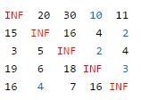
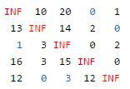
After reducing the row, we get the below reduced matrix.

Slide 15
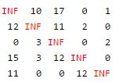
We then reduce the minimum value in each column from each element in that column. Minimum in each column is marked by blue [1 0 3 0 0]. After reducing the column, we get below the reduced matrix. This matrix will be further processed by child nodes of the root node to calculate their lower bound.
The total expected cost at the root node is the sum of all reductions.
Cost = [10 2 2 3 4] + [1 0 3 0 0] = 25
Since we have discovered the root node C0, the next node to be expanded can be any node from C1, C2, C3, C4. Whichever node has a minimum cost will be expanded further. So, we have to find out the expanding cost of each node.
The parent node C0 has below reduced matrix:

Slide 16
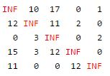
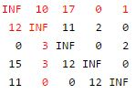
Let’s consider an edge from 0 —> 1.
1. As we add an edge (0, 1) to our search space, set outgoing edges for city 0 to INFINITY and all incoming edges to city 1 to INFINITY. We also set (1, 0) to INFINITY.
So in a reduced matrix of the parent node, change all the elements in row 0 and column 1 and at index (1, 0) to INFINITY (marked in red).

Slide 17
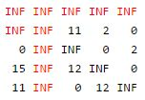
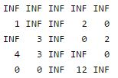
The resulting cost matrix is:
2. Now calculate the lower bound of the path starting at node 2 using the approach discussed earlier. The resultant matrix will be:
Therefore, for node 2, the cost will be
Cost = cost of node 0 + cost of the edge(0, 2) + lower bound of the path starting at node 2 = 25 + 17 + 11 = 53

Slide 18
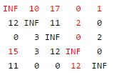
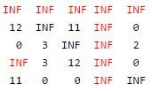
Let’s consider an edge from 0 —> 3.
Change all the elements in row 0 and column 3 and at index (3, 0) to INFINITY (marked in red).
The resulting cost matrix is:

Slide 19
2. Now calculate the lower bound of the path starting at node 3 using the approach discussed earlier. The lower bound of the path starting at node 3 is 0 as it is already in reduced form, i.e., all rows and all columns have zero value.
Therefore, for node 3, the cost will be
Cost = cost of node 0 + cost of the edge(0, 3) + lower bound of the path starting at node 3 = 25 + 0 + 0 = 25
Similarly, we calculate the cost of 0 —> 4. Its cost will be 31.
Now find a live node with the least estimated cost. Live nodes 1, 2, 3, and 4 have costs 35, 53, 25, and 31, respectively. The minimum among them is node 3, having cost 25. So, node 3 will be expanded further, as shown in the state-space tree diagram. After adding its children to the list of live nodes, find a live node with the least cost and expand it. Continue the search till a leaf is encountered in the space search tree. If a leaf is encountered, then the tour is completed, and we will return to the root node.
So the shortest path is 1- 4-2-5-3-1

Slide 20


